Slide 1
Setac: A Phased Deterministic Testing Framework for Scala Actors
Samira Tasharofi, Milos Gligoric, Darko Marinov, and Ralph Johnson

Slide 2
Background
Two approaches for parallel programming
Shared-memory
Do not scale with the number of cores
Cannot be applied for distributed systems
Message-passing
Best solution for distributed Systems
Can scale with the number of cores
Actor model
A model for message-passing programming
Supported by many libraries and languages
Scala, Erlang, C#, C++, Groovy(java-based), etc.

Slide 3
Actor Model
Actor is a computational entity with a mail box and local state
Deliver a message
Append the message to the mail box
Process a message
Extract a message from the mail box and execute that
Determined by message handler
In response to a message it processes:
Changes its local state
Sends messages to other actors
Creates new actors

Slide 4
Actors in Scala
Package scala.actors in Scala library
Developed by Philipp Haller
Features
Synchronous and asynchronous communication
Dynamic creation/destroying of actors
Exception handling
Remote actors
Customization of the thread pool executing actors

Slide 5
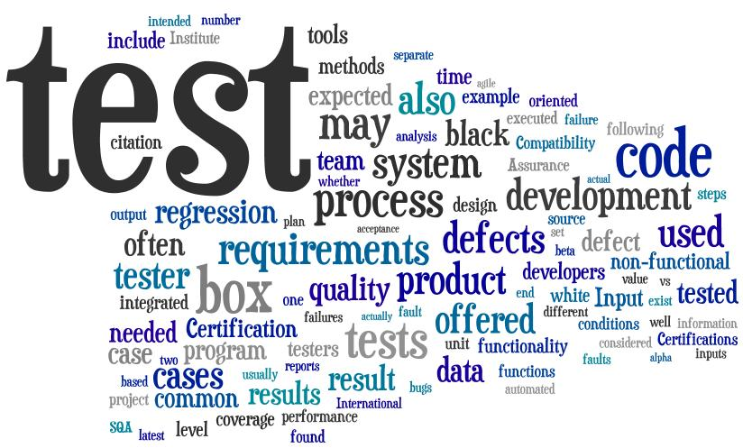
Question
How to test actor systems?

Slide 6
Problems
Schedule is a source of non-determinism in concurrent programs
Shared memory: order of accesses
Message-passing: order of messages
The output of the program might be different for a given input depending on the schedule
The bugs may only show up during some specific schedules
Systematic exploration can lead to state space explosion
Asynchronous events don not have instant effects

Slide 7
Example: BoundedBuffer
class BoundedBuffer(maxSize: Int) extends Actor {
var content = new Array[Int](size)
var head, tail, curSize = 0
start
override def act() = loop {
react {
case Put(x) if (curSize < maxSize) => {
content(tail) = x
tail = (tail + 1) % size
curSize += 1
}
case Get if (curSize > 0) => {
val r = content(head)
head = (head + 1) % size
curSize -= 1
reply(r)
}
}
}
}
class Producer(buf: Actor) extends Actor {
start
override def act() = loop {
react {
case Produce(values) =>
values.foreach(v => buf ! Put(v))
}
}
}
class Consumer(buf: Actor) extends Actor {
var token = -1
start
override def act() = loop {
react {
case Consume(count) =>
for (i <- 0 to count-1)
token = (buf !? Get).asInstanceOf[Int]
}
}
}

Slide 8
BufferTest
producer
Put(4), Put(5)
class BufferTest {
@Test
def testBuffer() {
val buf = new BoundedBuffer(1)
val consumer = new Consumer(buf)
val producer = new Producer(buf)
producer ! Produce(List(4, 5))
consumer ! Consume(2)
// consumer should receive 4 and 5
assert(… )
}
buffer(1)
Get, Get
consumer
4, 5

Slide 9
Buggy BoundedBuffer
class BoundedBuffer(maxSize: Int) extends Actor {
var content = new Array[Int](size)
var head, tail, curSize = 0
start
override def act() = loop {
react {
case Put(x) if (curSize maxSize) => {
content(tail) = x
tail = (tail + 1) % size
curSize += 1
}
case Get if (curSize > 0) => {
val r = content(head)
head = (head + 1) % size
curSize -= 1
reply(r)
}
}
}
}
Bug
<
<=
Notes:
A buffer with capacity of one.

Slide 10
Buggy BoundedBuffer: Schedules in BufferTest
class BoundedBuffer(maxSize: Int) extends Actor {
var content = new Array[Int](size)
var head, tail, curSize = 0
start
override def act() = loop {
react {
case Put(x) if (curSize maxSize) => {
content(tail) = x
tail = (tail + 1) % size
curSize += 1
}
case Get if (curSize > 0) => {
val r = content(head)
head = (head + 1) % size
curSize -= 1
reply(r)
}
}
}
}
consumer
producer
buffer(1)
Put(4)
<=
Get
4
Put(5)
5
Get
Error!
5
5

Slide 11
Correct BoundedBuffer: Checking Assertions in Test
class BoundedBuffer(maxSize: Int) extends Actor {
var content = new Array[Int](size)
var head, tail, curSize = 0
start
override def act() = loop {
react {
case Put(x) if (curSize < maxSize) => {
content(tail) = x
tail = (tail + 1) % size
curSize += 1
}
case Get if (curSize > 0) => {
val r = content(head)
head = (head + 1) % size
curSize -= 1
reply(r)
}
}
}
}
class SimpleBufferTest {
@Test
def testBuffer() {
val buf = new BoundedBuffer(1)
buf ! Put(4)
assert(buf.curSize == 1)
}
Fails!!
buffer
Put(4)
mailbox
local state
…
content, head, tail, curSize
Fails!!
assert

Slide 12
Testing Actor Programs
Problems:
How to write unit tests for Actor programs while controlling the schedule?
How to check assertions at appropriate times?
Current Solutions:
Using synchronization constructs, e.g. Latches and Barriers
Using Thread.sleep

Slide 13
BufferTest: A Test Schedule
Consumer
Producer
BoundedeBuffer(1)
Phase 1
Get
Check assertions
Put(4)
4
Phase 2
Put(5)
Check assertions
Get
Phase 3
5
Check assertions

Slide 14
Traditional: BufferTest
class BufferTest {
@Test
def testBuffer() {
val putLatch = new CountDownLatch(2)
val getLatch = new CountDownLatch(2)
val buf =
new BoundedBuffer(1, putLatch, getLatch)
val consumeLatch = new CountDownLatch(1)
val consumer = new Consumer(buf, consumeLatch)
val producer = new Producer(buf)
//Phase 1
consumer ! Consume(1)
consumeLatch.await()
Thread.sleep(1000)
assert(consumer.getState == State.Blocked &&
buf.curSize == 0)
// …
}
}
producer
buffer(1)
consumer
Get
Phase 1
class Consumer(buf: Actor, consumeLatch: CountDownLatch) extends Actor {
var token = -1
start
override def act() = loop {
react {
case Consume(count) =>
consumeLatch.countDown()
for (i <- 0 to count-1)
token = (buf !? Get).asInstanceOf[Int]
}
}
}

Slide 15
Traditional: BufferTest (cont)
consumer
producer
buffer(1)
Put(4)
class BoundedBuffer(maxSize: Int, putLatch: CountDownLatch, getLatch: CountDownLatch) extends Actor {
var content = new Array[Int](size)
var head, tail, curSize = 0
start
override def act() = loop {
react {
case Put(x) if (curSize < maxSize) => {
content(tail) = x
tail = (tail + 1) % size
curSize += 1
putLatch.countDown()
}
case Get if (curSize > 0) => {
val r = content(head)
head = (head + 1) % size
curSize -= 1
reply(r)
getLatch.countDown()
}
}
}
}
Phase 2
4
Put(5)
Get
Phase 3
5
class BufferTest {
@Test
def testBuffer() {
// …
//Phase 2
producer ! Produce(List(4, 5))
putLatch.await()
assert(consumer.token == 4 && buf.curSize == 1)
// Phase 3
consumer ! Consume(1)
getLatch.await()
assert(consumer.token == 5 && buf.curSize == 0)
}
}

Slide 16
Traditional BufferTest Problems
Unreliable
Thread.sleep
Complexity and Deadlock possibility
Latches and Barriers
Costly
Changing the program under test

Slide 17
Setac
Specify tests with some constraints on the schedule
Partial order of schedule messages
Centralized schedule, less complexity
Checking assertions when the system is stable
There is no message that can be processed
No progress in the system
No change in the run time environment
Minimal changes in the program under test

Slide 18
Setac: BufferTest
class BufferTest extends SetacTest {
@Test
def testBuffer() {
val buf = new BoundedBuffer(1)
val consumer = new Consumer(buf)
val producer = new Producer(buf)
val put4 = createScheduleMessage(producer, buf, Put(4))
val put5 = createScheduleMessage(producer, buf, Put(5))
val gets = createMultipleScheduleMessage(2, consumer, buf, Get)
producer ! Produce(List(4, 5))
consumer ! Consume(2)
//Phase 1
setSchedule(gets(0))
assertWhenStable(consumer.isBlocked && buf.curSize == 0)
//Phase 2
setSchedule(put4 -> put5)
assertWhenStable(consumer.token == 4 && buf.curSize == 1 && put5.isProcessed)
// Phase 3
setSchedule(gets(1))
assertWhenStable(consumer.token == 5 && buf.curSize == 0)
}
}

Slide 19
Setac: BufferTest (cont)
class BoundedBuffer(size: Int) extends Actor {
// …
}
class Consumer(buf: Actor) extends Actor {
// …
}
class Producer(buf: Actor) extends Actor {
// …
}
TestActor {
TestActor {
TestActor {

Slide 20
Setac: BufferTest
Removed Thread.sleep
More reliable
Removed synchronization constructs, e.g. Latches
Reduced complexity
Minimized changes in the program under test

Slide 21
Setac APIs
Follows widely used style for unit testing
Integrated with Junit
Refined over time based on examples
Checking assertions when system is stable
Total and partial order of schedule messages
Status of Test messages
Processed, delivered, etc.
Status of actors
Mail box: Number of messages, content of mail box, etc.
Execution Status: Blocked, Running, Suspended

Slide 22
Limitations
Handling non-stable systems
receiveWithin, reactWithin, etc. in a loop
Use assertAfter API in Setac
Managing anonymous actors
E.g., Futures
Handling actors whose source code is not available

Slide 23
Conclusions
Large number of schedules in actor programs
Only some schedules might be important to test
It is non-trivial to force specific schedule and check assertions at appropriate times
Sleeps - unreliable
Latches – hard to write/read
Changes in the program under test- high cost
Setac
Reliable
Easy to write
Very minimal changes in the program under test
Open for collaboration
Please try it: http://mir.cs.illinois.edu/setac/

Slide 24
Project Proposals
Akka
A better designed actor library for Scala users
Supported by Typesafe and has been used for large real projects
http://akka.io/docs/akka/1.1.3/additional/companies-using-akka.html
Users always suffer from the lack of a testing framework
Users don’t know how to test their actors
Porting Setac for Akka
A great contribution to Akka project
Bigger user community
Evaluating Setac
Introducing a new approach/philosophy for testing actors

Slide 25
Project Proposals
Identifying the challenges and solutions for testing actor systems
The most common bugs in actor systems (bug patterns)
How to detect them and remove them
How to prevent them from happening
Facilitate Testing
Trace simplification for debugging
Record and replay traces
Propose interesting schedules

Slide 26
Let’s Have a Big Contribution

