Slide 1
Approximate Transformations as Mutation Operators
ICST’18 – Västerås, Sweden
April 12th, 2018
Farah Hariri†, August Shi†, Owolabi Legunsen†
Milos Gligoric‡, Sarfraz Khurshid‡, Sasa Misailovic†
†
‡
CCF- 1409423, CCF-1421503,
CCF-1566363, CCF-1629431,
CCF- 1652517, CCF-1703637,
and CCF-1704790

Slide 2
Motivation
Mutation Testing
Goal: Technique that evaluates the quality of test suites

Slide 3
Motivation
Mutation Testing
Goal: Technique that evaluates the quality of test suites
How: Introduces small syntactic change to the program
Example:
x = x + 1

Slide 4
Motivation
Mutation Testing
Goal: Technique that evaluates the quality of test suites
How: Introduces small syntactic change to the program
Example:
x = x + 2

Slide 5
Motivation
Mutation Testing
Goal: Technique that evaluates the quality of test suites
How: Introduces small syntactic change to the program
Example:
x = x + 2
Approximate Computing
Goal: Technique that trades accuracy for performance

Slide 6
Motivation
Mutation Testing
Goal: Technique that evaluates the quality of test suites
How: Introduces small syntactic change to the program
Example:
x = x + 2
Approximate Computing
Goal: Technique that trades accuracy for performance
How: Introduces small syntactic changes to the program
Example:
for (i=0; i<n; i=i+1)

Slide 7
Motivation
Mutation Testing
Goal: Technique that evaluates the quality of test suites
How: Introduces small syntactic change to the program
Example:
x = x + 2
Approximate Computing
Goal: Technique that trades accuracy for performance
How: Introduces small syntactic changes to the program
Example:
for (i=0; i<n; i=i+2)

Slide 8
Motivation
Mutation Testing
Goal: Technique that evaluates the quality of test suites
How: Introduces small syntactic change to the program
Example:
x = x + 2
Approximate Computing
Goal: Technique that trades accuracy for performance
How: Introduces small syntactic changes to the program
Example:
for (i=0; i<n; i=i+2)

Slide 9
Motivation
Mutation Testing
Goal: Technique that evaluates the quality of test suites
How: Introduces small syntactic change to the program
Example:
x = x + 2
Approximate Computing
Goal: Technique that trades accuracy for performance
How: Introduces small syntactic changes to the program
Example:
for (i=0; i<n; i=i+2)

Slide 10
Vision
To provide insights, mutation testing needs:
Varied mutation operators
High quality mutation operators
We propose Approximate Transformations (ATs) as a new class of mutation operators leading to different program behaviors

Slide 11
Background: Mutation Testing
Definition: Mutation testing is a technique for evaluating the quality of test suites
Code Under Test
Mutation Testing
Mutation Score (%)
Test Suite

Slide 12
STEPS OF MUTATION TESTING
RUNNING THE TEST SUITE TO DETERMINE KILLED MUTANTS
02
MUTANT GENERATION
01

Slide 13
STEPS OF MUTATION TESTING
RUNNING THE TEST SUITE TO DETERMINE KILLED MUTANTS
02
MUTANT GENERATION
01

Slide 14
Vectorz Mutation Example
public void swapRows(int i, int j) { if (i == j) return; int a = i * cols; int b = j * cols; int cc = columnCount(); for (int k = 0; k < cc; k++) { int i1 = a + k; int i2 = b + k; double t = data[i1]; data[i1] = data[i2]; data[i2] = t; } }

Slide 15
Vectorz Mutation Example
public void swapRows(int i, int j) { if (i == j) return; int a = i * cols; int b = j / cols; int cc = columnCount(); for (int k = 0; k < cc; k++) { int i1 = a + k; int i2 = b + k; double t = data[i1]; data[i1] = data[i2]; data[i2] = t; } }

Slide 16
STEPS OF MUTATION TESTING
RUNNING THE TEST SUITE TO DETERMINE KILLED MUTANTS
02
MUTANT GENERATION
01

Slide 17
Running The Test Suite Outcomes
Mutant 1
Test Runner
P P F P P
Mutant is killed
Test Suite
Mutant 2
Test Runner
P F P P F
Mutant is killed
Test Suite
Mutant 3
Test Runner
P P P P P
Mutant is surviving
(NOT killed)
Test Suite

Slide 18
Mutation Score Computation
Mutant 1
Test Runner
P P F P P
Test Suite
Mutant 2
Test Runner
$$mutation score\left(\%\right)$$
$$=\frac{killed mutants}{all generated mutants}$$
P F P P F
Test Suite
Mutant 3
Test Runner
P P P P P
Test Suite

Slide 19
Vectorz Killed Mutant Example
public void swapRows(int i, int j) { if (i == j) return; int a = i * cols; int b = j / cols; int cc = columnCount(); for (int k = 0; k < cc; k++) { int i1 = a + k; int i2 = b + k; double t = data[i1]; data[i1] = data[i2]; data[i2] = t; } }
private void doSwapTest(AMatrix m) { if ((m.rowCount()<2)||(m.columnCount()<2)) return;
m=m.clone(); AMatrix m2=m.clone(); m2.swapRows(0, 1); assert(!m2.equals(m)); m2.swapRows(0, 1); assert(m2.equals(m)); ...}
Notes:
Example of killed mutant by the test suite
Mention that they are integers and therefore the division will lead to zero

Slide 20
Vectorz Killed Mutant Example
public void swapRows(int i, int j) { if (i == j) return; int a = i * cols; int b = j / cols; int cc = columnCount(); for (int k = 0; k < cc; k++) { int i1 = a + k; int i2 = b + k; double t = data[i1]; data[i1] = data[i2]; data[i2] = t; } }
private void doSwapTest(AMatrix m) { if ((m.rowCount()<2)||(m.columnCount()<2)) return;
m=m.clone(); AMatrix m2=m.clone(); m2.swapRows(0, 1); assert(!m2.equals(m)); m2.swapRows(0, 1); assert(m2.equals(m)); ...}
Mutant is killed
Notes:
Example of killed mutant by the test suite

Slide 21
Background: Approximate Transformations
Semantic changing transformations
Trade accuracy for performance
Big popularity in research recently
Machine learning, multimedia, data mining, …
Example Transformations:
Integer to short precision degradation
Loop perforation

Slide 22
Vectorz Precision Degradation Example
public void swapRows(int i, int j) { if (i == j) return; int a = i * cols; int b = j * cols; int cc = columnCount(); for (int k = 0; k < cc; k++) { int i1 = a + k; int i2 = b + k; double t = data[i1]; data[i1] = data[i2]; data[i2] = t; } }

Slide 23
Vectorz Precision Degradation Example
public void swapRows(int i, int j) { if (i == j) return; int a = i * cols; int b = j * cols; int cc = columnCount(); for (int k = 0; k < cc; k++) { int i1 = (short) (a + k); int i2 = b + k; double t = data[i1]; data[i1] = data[i2]; data[i2] = t; } }
Integer to short precision degradation

Slide 24
Vectorz Precision Degradation Example
public void swapRows(int i, int j) { if (i == j) return; int a = i * cols; int b = j * cols; int cc = columnCount(); for (int k = 0; k < cc; k++) { int i1 = (short) (a + k); int i2 = b + k; double t = data[i1]; data[i1] = data[i2]; data[i2] = t; } }
private void doSwapTest(AMatrix m) { if ((m.rowCount()<2)||(m.columnCount()<2)) return;
m=m.clone(); AMatrix m2=m.clone(); m2.swapRows(0, 1); assert(!m2.equals(m)); m2.swapRows(0, 1); assert(m2.equals(m)); ...}
Mutant is NOT killed
Notes:
Example of killed mutant by the test suite

Slide 25
Vectorz Loop Perforation Example
public void swapRows(int i, int j) { if (i == j) return; int a = i * cols; int b = j * cols; int cc = columnCount(); for (int k = 0; k < cc; k++) { int i1 = a + k; int i2 = b + k; double t = data[i1]; data[i1] = data[i2]; data[i2] = t; } }

Slide 26
Vectorz Loop Perforation Example
public void swapRows(int i, int j) { if (i == j) return; int a = i * cols; int b = j * cols; int cc = columnCount(); for (int k = 0; k < cc; k+=2) { int i1 = a + k; int i2 = b + k; double t = data[i1]; data[i1] = data[i2]; data[i2] = t; } }
Loop Perforation

Slide 27
Vectorz Loop Perforation Example
public void swapRows(int i, int j) { if (i == j) return; int a = i * cols; int b = j * cols; int cc = columnCount(); for (int k = 0; k < cc; k+=2) { int i1 = a + k; int i2 = b + k; double t = data[i1]; data[i1] = data[i2]; data[i2] = t; } }
private void doSwapTest(AMatrix m) { if ((m.rowCount()<2)||(m.columnCount()<2)) return;
m=m.clone(); AMatrix m2=m.clone(); m2.swapRows(0, 1); assert(!m2.equals(m)); m2.swapRows(0, 1); assert(m2.equals(m)); ...}
Notes:
Example of killed mutant by the test suite

Slide 28
Vectorz Loop Perforation Example
public void swapRows(int i, int j) { if (i == j) return; int a = i * cols; int b = j * cols; int cc = columnCount(); for (int k = 0; k < cc; k+=2) { int i1 = a + k; int i2 = b + k; double t = data[i1]; data[i1] = data[i2]; data[i2] = t; } }
private void doSwapTest(AMatrix m) { if ((m.rowCount()<2)||(m.columnCount()<2)) return;
m=m.clone(); AMatrix m2=m.clone(); m2.swapRows(0, 1); assert(!m2.equals(m)); m2.swapRows(0, 1); assert(m2.equals(m)); ...}
Mutant is NOT killed
Notes:
Those slides basically showed us how it would be like to use approx. transformations as mutation operators, and the value they can bring pointing out weaknesses in the test suite

Slide 29
Research questions
RQ1 How effective are ATs as mutation operators, compared to conventional mutation operators?
RQ2 What code patterns do ATs as mutation operators reveal?
RQ3 How can ATs as mutation operators help software testing practice?

Slide 30
Experimental Setup
We perform our study on 3 ATs
Loop Perforation (LPM)
Double To Float Precision Degradation (DTF)
Integer To Short Precision Degradation (ITS)
Implement them as an extension to the PIT framework
We compare against 14 PIT operators on 9 Open Source Java projects
Notes:
Say something about how these transformations are representative of other approximate transformations

Slide 31
RQ1: How effective are ATs as mutation operators, compared to conventional mutation operators?

Slide 32
Quantitative Analysis
Mutation Score
Minimal Mutants
Sufficient Mutation Operators
ATs Effectiveness

Slide 33
Quantitative Analysis
Mutation Score
Minimal Mutants
Sufficient Mutation Operators
ATs Effectiveness

Slide 34
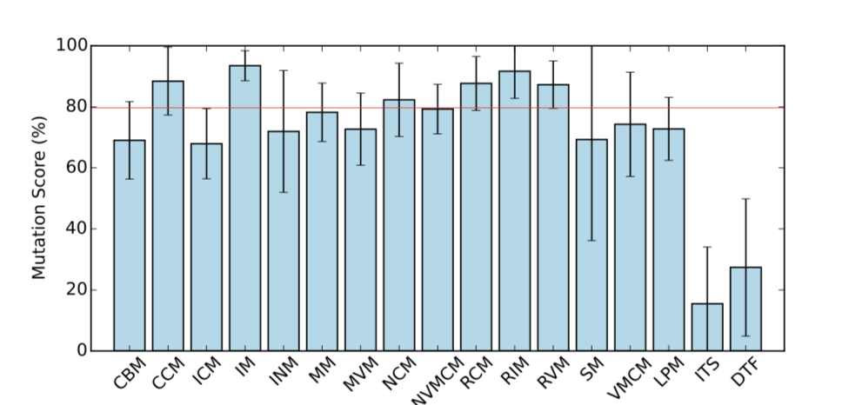
Mutation Score
79.65%

Slide 35
Mutation Score
79.65%
72.78%

Slide 36
Mutation Score
79.65%
72.78%
27.39%
15.49%

Slide 37
Mutation Score
LPM mutants are as hard/easy to kill as conventional mutation operators
DTF and ITS mutation scores are low due to bad tests ➔ provide value for improving the test suite

Slide 38
Quantitative Analysis
Mutation Score
Minimal Mutants
Sufficient Mutation Operators
ATs Effectiveness

Slide 39
Minimal Mutants
Proxies to find the mutants that are harder to kill among the generated ones

Slide 40
Minimal Mutants
Proxies to find the mutants that are harder to kill among the generated ones
Dynamic Subsumption:
m
m’
t1
t2
t3
t1
t2
t3
t4
m’’
t1
t2
t4

Slide 41
Minimal Mutants
Proxies to find the mutants that are harder to kill among the generated ones
Dynamic Subsumption:
m
subsumes (harder to kill than)
m’
t1
t2
t3
t1
t2
t3
t4
m’’
t1
t2
t4

Slide 42
Minimal Mutants
Proxies to find the mutants that are harder to kill among the generated ones
Dynamic Subsumption:
m
m’
t1
t2
t3
t1
t2
t3
t4
m’’
t1
t2
t4

Slide 43
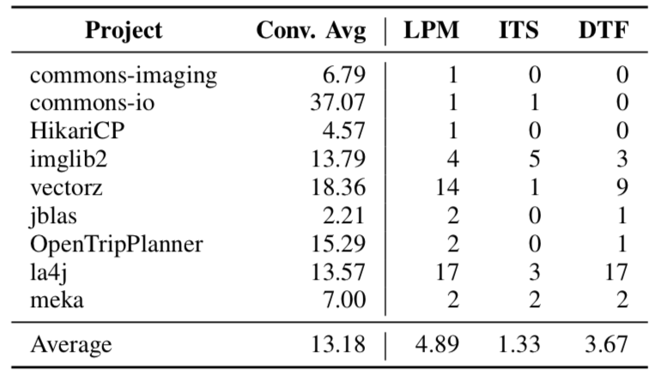
Minimal Mutants

Slide 44
Quantitative Analysis
Mutation Score
Minimal Mutants
Sufficient Mutation Operators
ATs Effectiveness

Slide 45
Sufficient Mutation Operators
Selective mutation analysis: heuristic for reducing the number of mutants to be run
Tests that kill mutants from the sufficient mutation operators are also sufficient to kill mutants generated by other operators

Slide 46
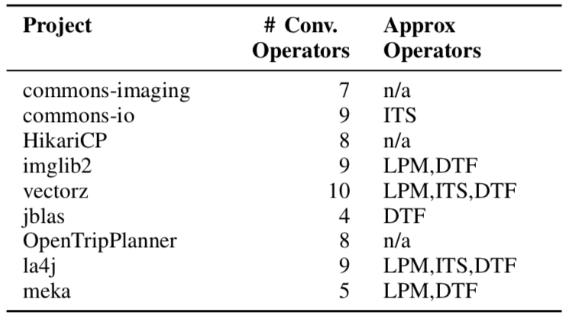
Sufficient Mutation Operators

Slide 47
Sufficient Mutation Operators
Notes:
The fact that approximate transformations end up in the sufficient mutation operator sets shows that they are important, since sufficient mutation operators are meant to be representative of all operators

Slide 48
Summary of RQ1
LPM mutants are as hard/easy to kill as mutants from conventional operators
DTF and ITS mutation scores were low due to bad tests
ATs generate mutants that subsume mutants from other operators
ATs are a category of their own, not subsumed by other operators
Results generalize beyond PIT to other mutation tools

Slide 49
RQ2: What code patterns do ATs as mutation operators reveal?

Slide 50
Qualitative Analysis
Sampled 5% of surviving and 5% of killed LPM mutants (125 mutants)
Sampled 1% of surviving and 1% of killed DTF and ITS mutants (121 mutants)

Slide 51
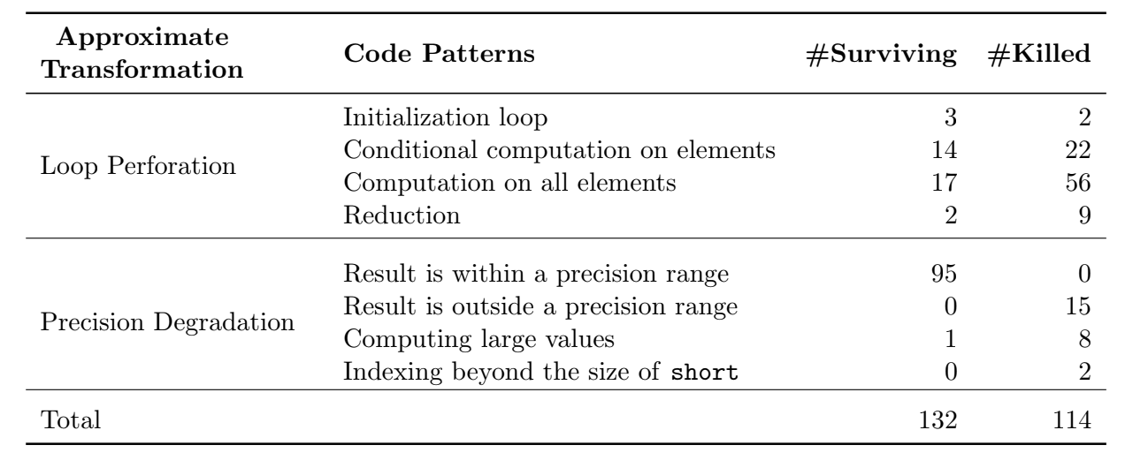
Code Patterns

Slide 52
Conditional Computation on Elements Pattern
public int argmin() {
if (isEmpty()) { return −1; }
double v = Double.POSITIVE_INFINITY;
int a = −1;
for (int i = 0; i < length; i+=2) {
if (!Double.isNaN(get(i)) && get(i) < v) v = get(i); a = i;
}
return a;
}
@Test
public void testArgMinMax() {
A = new DoubleMatrix(4, 3, 1.0, 2.0, 3.0, 4.0, 5.0, 6.0, 7.0, 8.0, 9.0, 10.0, 11.0, 12.0);
assertEquals(0, A.argmin(), eps);
…
}
Notes:
As a loop iterates over all elements in a data structure, the loop body checks whether a condition holds before performing the computation.
Jblas example
The LPM mutant is not killed by testArgMinMax(), because the index with the minimum element is not skipped.
TODO: potentially add one pattern for precision degradation

Slide 53
RQ3: How can ATs as mutation operators help software testing practice?

Slide 54
Practical Impact on Software Testing
Mutation Testing Theory: Interpreting Mutation Testing Results
Developers Community: Lessons learned, pull requests

Slide 55
Practical Impact on Software Testing
Mutation Testing Theory: Interpreting Mutation Testing Results
Developers Community: Lessons learned, pull requests

Slide 56
Interpreting Mutation Testing Results
Equivalent
Mutant
public void swapRows(int i, int j) { if (i == j) return; int a = i * cols; int b = j * cols; int cc = columnCount(); for (int k = 0; k < cc; k++) { int i1 = a + k; int i2 = b + k; double t = data[i1]; data[i1] = data[i2]; data[i2] = t; } }
public void swapRows(int i, int j) { if (i == j) return; int a = i * cols; int b = j / cols; int cc = columnCount(); for (int k = 0; k < cc; k+=2) { int i1 = a + k; int i2 = b + k; double t = data[i1]; data[i1] = data[i2]; data[i2] = t; } }
Run Tests
mutate
survived
Bad Tests
Notes:
Traditionally,

Slide 57
Interpreting Mutation Testing Results
Equivalent
Mutant
public void swapRows(int i, int j) { if (i == j) return; int a = i * cols; int b = j * cols; int cc = columnCount(); for (int k = 0; k < cc; k++) { int i1 = a + k; int i2 = b + k; double t = data[i1]; data[i1] = data[i2]; data[i2] = t; } }
public void swapRows(int i, int j) { if (i == j) return; int a = i * cols; int b = j / cols; int cc = columnCount(); for (int k = 0; k < cc; k+=2) { int i1 = a + k; int i2 = b + k; double t = data[i1]; data[i1] = data[i2]; data[i2] = t; } }
Run Tests
mutate
survived
Bad Tests
Approximable
Code
Notes:
Traditionally, we have two options; either the mutant is semantically equivalent to the original program, or the survival of the mutant indicate a buggy/inadequate/missing test (BAD test).
However, we found that there is a 3rd possibility; the mutant is semantically different from the original program, but produces acceptable outcomes that are within the range of precision. This applies not only to approx., but to other mutants in general.
We acknowledge that specifying approx. is hard. It is dependent on the domain knowledge, on the usage context, and the quality of the tests.

Slide 58
Interpreting Mutation Testing Results
 | Loop Perforation | Precision Degradation
Equivalent Mutants (%) | - | 14.58
Bad Tests (%) | 63.83 | 53.13
Approximable Code (%) | 19.15 | 11.46
Hard to Inspect (%) | 17.02 | 20.83

Slide 59
Practical Impact on Software Testing
Mutation Testing Theory: Interpreting Mutation Testing Results
Developers Community: Lessons learned, pull requests

Slide 60
Lessons (Re)Learned
Better loop coverage
Better coverage of loop condition
Check all output elements
Exercise boundary values
Notes:
Even though these insights are not new to the testing community, the real value lies in the fact that the approximate transformations are able to detect those problems, bringing them to the attention of the developer who might not have such considerations in mind.
We also submitted pull requests that fix bad tests, to evaluate whether these insights can help developers improve their test suites.

Slide 61
Lessons (Re)Learned
Better loop coverage
Better coverage of loop condition
Check all output elements
Exercise boundary values

Slide 62
Bad Test - Pull Request Example
public void swapRows(int i, int j) { if (i == j) return; int a = i * cols; int b = j / cols; int cc = columnCount(); for (int k = 0; k < cc; k+=2) { int i1 = a + k; int i2 = b + k; double t = data[i1]; data[i1] = data[i2]; data[i2] = t; } }
private void doSwapTest(AMatrix m) { if ((m.rowCount()<2)||(m.columnCount()<2)) return;
m=m.clone(); AMatrix m2=m.clone(); m2.swapRows(0, 1); assert(!m2.equals(m)); m2.swapRows(0, 1); assert(m2.equals(m)); ...}

Slide 63
Bad Test - Pull Request Example
public void swapRows(int i, int j) { if (i == j) return; int a = i * cols; int b = j / cols; int cc = columnCount(); for (int k = 0; k < cc; k+=2) { int i1 = a + k; int i2 = b + k; double t = data[i1]; data[i1] = data[i2]; data[i2] = t; } }
private void doSwapTest(AMatrix m) { if ((m.rowCount()<2)||(m.columnCount()<2)) return;
m=m.clone(); AMatrix m2=m.clone(); m2.swapRows(0, 1); assert(!m2.equals(m));
+ assertEquals(m2.getRow(0), m.getRow(1)); + assertEquals(m2.getRow(1), m.getRow(0)); m2.swapRows(0, 1); assert(m2.equals(m)); ...}

Slide 64
Takeaways
We propose ATs as mutation operators
Our results show that:
ATs generate mutants that are not subsumed by conventional operators
ATs exercise unique code patterns
We propose approximable code as a third way of interpreting surviving mutants
Survived mutants inspired better testing practices (11 pull requests)

Slide 65
Future Work
Automate approximable code detection
Explore the dual direction: how can mutation testing benefit approximate computing?

