Slide 1
Comparing Mutation Testing at the Levels of Source Code and Compiler Intermediate Representation
Farah Hariri, August Shi, Vimuth Fernando, Suleman Mahmood, Darko Marinov
ICST 2019
Xi’an, China
4/24/2019
CCF-1421503 CCF-1629431
CNS-1646305
CNS-1740916
Notes:
My name is August Shi, and I am here to present our work “Comparing Mutation Testing at the Levels of Source Code and Compiler Intermediate Representation.”
This is joint work with Farah Hariri, Vimuth Fernando, Suleman Mahmood, and Darko Marinov, and we are all from the University of Illinois at Urbana-Champaign

Slide 2
Mutation Testing
$$Mutation Score=\frac{\# Mutants Killed}{\# Mutants Generated}$$
Higher mutation score Better test suite
Check quality of test suite
Mutant Generation
Mut 1
Run Tests
Survived
Program
Mut 2
Run Tests
Killed
…
Mutation Operators
SRC or IR?
Notes:
Our work pertains to mutation testing, and I know many of you know what mutation testing is, but I will go over the background a bit…
The question we want to investigate in this work is which level of code representation should mutation testing tools operate on, SRC or IR?
So as I go over how we answer this question and our results, please think a bit about which level you think is better to work on…

Slide 3
SRC Mutation Example (C Language)
int max(int arr[], int size) {
int i;
int max = INT_MIN;
for (i = 0; i < size; i++) {
if (arr[i] > max) {
max = arr[i];
}
}
return max;
}
void testSingle() {
int arr[1] = {5};
assert(5 == max(arr, 1));
}
void testMulti() {
int arr[3] = {1, 3, 2};
assert(3 == max(arr, 3));
}
Test Passes
Test Passes
Notes:
First, I’d like to go into some examples about what I mean by mutating at SRC or IR
Here is an example code for computing the maximum value in an array, written using C…

Slide 4
SRC Mutation Example (C Language)
int max(int arr[], int size) {
int i;
int max = INT_MIN;
for (i = 1; i < size; i++) {
if (arr[i] > max) {
max = arr[i];
}
}
return max;
}
void testSingle() {
int arr[1] = {5};
assert(5 == max(arr, 1));
}
void testMulti() {
int arr[3] = {1, 3, 2};
assert(3 == max(arr, 3));
}
Test Fails
Test Passes
Integer Constant Replacement
Change 0 to 1

Slide 5
IR Mutation Example (LLVM)
define i32 @max(i32* %arr, i32 %size) {
%1 = alloca i32*, align 8
%2 = alloca i32, align 4
…
store i32 0, i32* %i, align 4
…
}
void testSingle() {
int arr[1] = {5};
assert(5 == max(arr, 1));
}
void testMulti() {
int arr[3] = {1, 3, 2};
assert(3 == max(arr, 3));
}
Notes:
Now let’s see what the code would look like at an IR level, specifically here in LLVM.
LLVM is our representative IR, LLVM is very popular and many languages compile to LLVM, e.g., C/C++, Julia, Swift, Rust

Slide 6
IR Mutation Example (LLVM)
define i32 @max(i32* %arr, i32 %size) {
%1 = alloca i32*, align 8
%2 = alloca i32, align 4
…
store i32 1, i32* %i, align 4
…
}
void testSingle() {
int arr[1] = {5};
assert(5 == max(arr, 1));
}
void testMulti() {
int arr[3] = {1, 3, 2};
assert(3 == max(arr, 3));
}
Test Fails
Integer Constant Replacement
Change 0 to 1
Test Passes
Notes:
…While this example shows how mutating at SRC and IR can generate the same mutant, that is not always the case. I’ll show some more examples of where they can differ later.

Slide 7
SRC vs IR (Qualitative)
SRC
IR
Understanding mutants
Mutants on code written by developer
Mutating generated code
May not matter if just comparing test suites
Tooling for many languages
Different tool for different languages
universalmutator¹
Tool applies for any language that compiles to same IR
¹Alex Groce, Josie Holmes, Darko Marinov, August Shi, Lingming Zhang, “An Extensible, Regular-Expression-Based Tool for Multi-Language Mutant Generation”, ICSE Demo 2017
Notes:
Let’s consider a few qualitative comparisons we can make between SRC and IR, things we can reason about without an empirical study.
First, in the scenario where a developer seeks to understand the mutants as to improve the test suite to kill unkilled mutants, SRC…
However, if the use case is to compare test suites just to see which is better or if there is an improvement in an improved test suite, it may not matter what the exact mutants are
Second, consider the ease of developing mutation testing for multiple languages…
Tool applies for many different languages for IR, e.g., many languages compile to LLVM such as Julia, Swift, Rust, C/C++

Slide 8
SRC vs IR (Quantitative) ?
Efficiency of mutation testing
Dominated by number of generated mutants
Effectiveness of mutation testing
Mutation scores
Correlation with faults
Effects of different operators
Mutant subsumption
See paper
Notes:
Some other factors to consider are more quantitative measures, such as…

Slide 9
SRCIROR
Mutation testing tool for SRC and IR levels²
https://github.com/TestingResearchIllinois/srciror
Same mutation operators on both levels
Arithmetic Operator Replacement, e.g., “+” “-”
Logical Connector Replacement, e.g., “&&” “||”
Relational Operator Replacement, e.g., “>” “<“
Integer Constant Replacement, e.g., “0” “1”
Same operators do not guarantee same mutants
Would SRC or IR have more mutants?
²Farah Hariri, August Shi, “SRCIROR: A Toolset for Mutation Testing of C Source Code and LLVM Intermediate Representation”, ASE Demo 2018
Notes:
We use SRCIROR, a mutation testing tool for both SRC and IR levels, namely for C/C++ and LLVM
The tool implements conceptually the same mutation operators at both levels, allowing fairer comparisons
Note that even with the same mutation operators, may not get the exact same mutants, i.e., same binaries, at the two different levels
More specifically, an interesting question would be if SRC or IR have more mutants
Let me show a few examples here…

Slide 10
More IR Mutants
...
change = mode_compile(mode)
if (!change) {
error(0, 0 _(“invalid mode: %s”),
quote(mode));
usage(EXIT_FAILURE);
}
...
Notes:
Let’s first consider an example where IR can have more mutants…

Slide 11
More IR Mutants
...
change = mode_compile(mode)
if (!(!change)) {
error(0, 0 _(“invalid mode: %s”),
quote(mode));
usage(EXIT_FAILURE);
}
...
Relational Operator Replacement
Negate the conditional
One possible mutant

Slide 12
More IR Mutants
...
change = mode_compile(mode)
if (!change) {
error(0, 0 _(“invalid mode: %s”),
quote(mode));
usage(EXIT_FAILURE);
}
...
...
%136 = icmp ne %struct.mc* %135, null
br i1 %136, label %141, label %137
...

Slide 13
More IR Mutants
...
change = mode_compile(mode)
if (!change) {
error(0, 0 _(“invalid mode: %s”),
quote(mode));
usage(EXIT_FAILURE);
}
...
Relational Operator Replacement
Change ne to eq
...
%136 = icmp eq %struct.mc* %135, null
br i1 %136, label %141, label %137
...

Slide 14
More IR Mutants
...
change = mode_compile(mode)
if (!change) {
error(0, 0 _(“invalid mode: %s”),
quote(mode));
usage(EXIT_FAILURE);
}
...
Relational Operator Replacement
Change ne to sgt
...
%136 = icmp sgt %struct.mc* %135, null
br i1 %136, label %141, label %137
...

Slide 15
More IR Mutants
...
change = mode_compile(mode)
if (!change) {
error(0, 0 _(“invalid mode: %s”),
quote(mode));
usage(EXIT_FAILURE);
}
...
Relational Operator Replacement
Change ne to ugt
...
%136 = icmp ugt %struct.mc* %135, null
br i1 %136, label %141, label %137
...

Slide 16
More IR Mutants
...
change = mode_compile(mode)
if (!change) {
error(0, 0 _(“invalid mode: %s”),
quote(mode));
usage(EXIT_FAILURE);
}
...
Relational Operator Replacement
Change ne to ugt
Nine possible mutants
...
%136 = icmp ugt %struct.mc* %135, null
br i1 %136, label %141, label %137
...
Notes:
The difference in representation and how the same things are expressed can result in different opportunities for mutation

Slide 17
More SRC Mutants
static bool
mode_changed(char const *file, mode_t old_mode, mode_t new_mode) {
if (new_mode & (04000|02000|01000)) {
...
}
...
}
Notes:
Now let’s consider an example where SRC can have more mutants…

Slide 18
More SRC Mutants
static bool
mode_changed(char const *file, mode_t old_mode, mode_t new_mode) {
if (new_mode & (04000|02000|01000)) {
...
}
...
}
Integer Constant Replacement
Change constant to {0, 1, -1, c + 1, c - 1}
3 x 5 = 15 possible mutants

Slide 19
More SRC Mutants
static bool
mode_changed(char const *file, mode_t old_mode, mode_t new_mode) {
if (new_mode & (04000|02000|01000)) {
...
}
...
}
define @mode_changed(i8* %file, i32 %old_mode, i32 %new_mode) {
...
%6 = and i32 %5, 3584
%7 = icmp ne i32 %6, 0
br i1 %7, label %8, label %25
... }
Integer Constant Replacement
Change 3584 to {0, 1, -1, c + 1, c – 1}
1 x 5 = 5 possible mutants
Notes:
So compiler optimizations when translating the same code from SRC to IR can lead to different opportunities in mutant generation
Now you may want to think which level might generate more mutants overall, before I show our results on number of generated mutants

Slide 20
Experimental Setup
Evaluate on 15 programs from Coreutils
Split test scripts into scripts that call program individually, create smaller test suites
Compiler optimizations at O3 for both levels
Compute equivalent/duplicated mutants
Trivial Compiler Equivalence³
Run tests for mutants in Docker containers
Isolate mutant effects from rest of system
³Mike Papadakis, Yue Jia, Mark Harman, Yves Le Traon, “Trivial compiler equivalence: A large scale empirical study of a simple, fast and effective equivalent mutant detection technique”, ICSE 2015
Notes:
1022 tests

Slide 21
Number of Generated Mutants
Level | # Stillborn Mutants | # Compiled Mutants | # Equiv | % Equiv | # Dup | % Dup | # NEND
SRC | 1401 | 36528 | 1848 | 5.1% | 4725 | 12.9% | 29955
IR | 15710 | 100111 | 6302 | 6.3% | 13963 | 13.9% | 79846
Many more IR mutants (2.7x)
Mutation testing slower at IR level

Slide 22
Equivalent and Duplicated Mutants
Level | # Stillborn Mutants | # Compiled Mutants | # Equiv | % Equiv | # Dup | % Dup | # NEND
SRC | 1401 | 36528 | 1848 | 5.1% | 4725 | 12.9% | 29955
IR | 15710 | 100111 | 6302 | 6.3% | 13963 | 13.9% | 79846
Similar % equivalent mutants
Similar % duplicated mutants

Slide 23
Equivalent and Duplicated Mutants
Level | # Stillborn Mutants | # Compiled Mutants | # Equiv | % Equiv | # Dup | % Dup | # NEND
SRC | 1401 | 36528 | 1848 | 5.1% | 4725 | 12.9% | 29955
IR | 15710 | 100111 | 6302 | 6.3% | 13963 | 13.9% | 79846
IR still has more Non-Equivalent Non-Duplicated
(NEND) mutants (2.6x)
Mutation testing remains slower at IR level

Slide 24
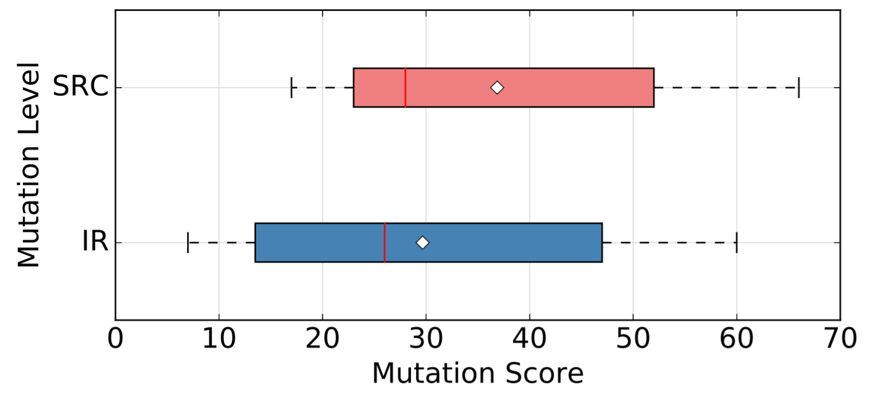
Mutation Score
= median
= mean
$$Mutation Score=\frac{\# Mutants Killed}{\# Mutants Generated}$$
Quite similar mutation scores
How do they correlate?
Notes:
If we compute the mutation scores computed using the full test suite for each subject, we see that between SRC and IR the scores are actually quite similar, with IR having slightly less…
Wilcoxon paired rank test shows no significant differences, Cliff-delta effect size difference is 0.28, very small
But another question to consider is how much SRC and IR actually agree on the relative quality of test suites

Slide 25
Correlating Mutation Scores
Do SRC and IR mutation scores indicate the same relative quality of test suites?
Create smaller test suites out of full test suite for each project
1/2, 1/4, 1/8, 1/16 sizes
10 test suites of each size
Compute mutation score of SRC and IR for each smaller test suite
Correlate scores for same test suites at both levels
Notes:
i.e., if they both find one test suite better than the other…

Slide 26
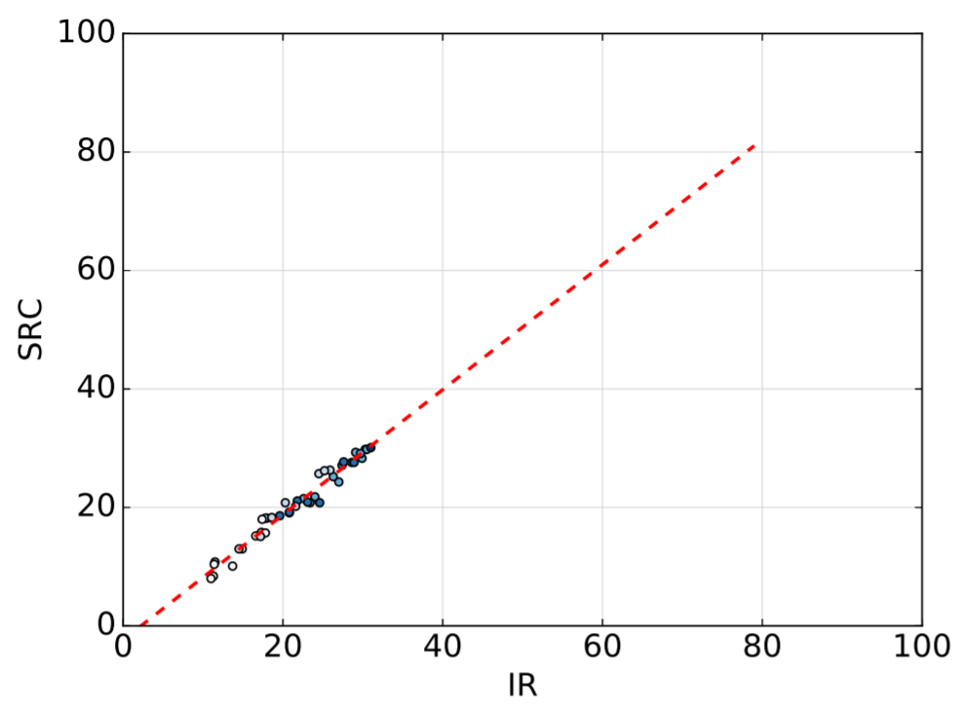
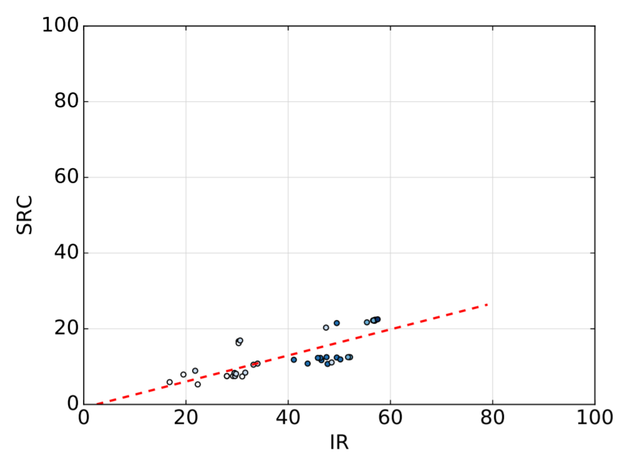
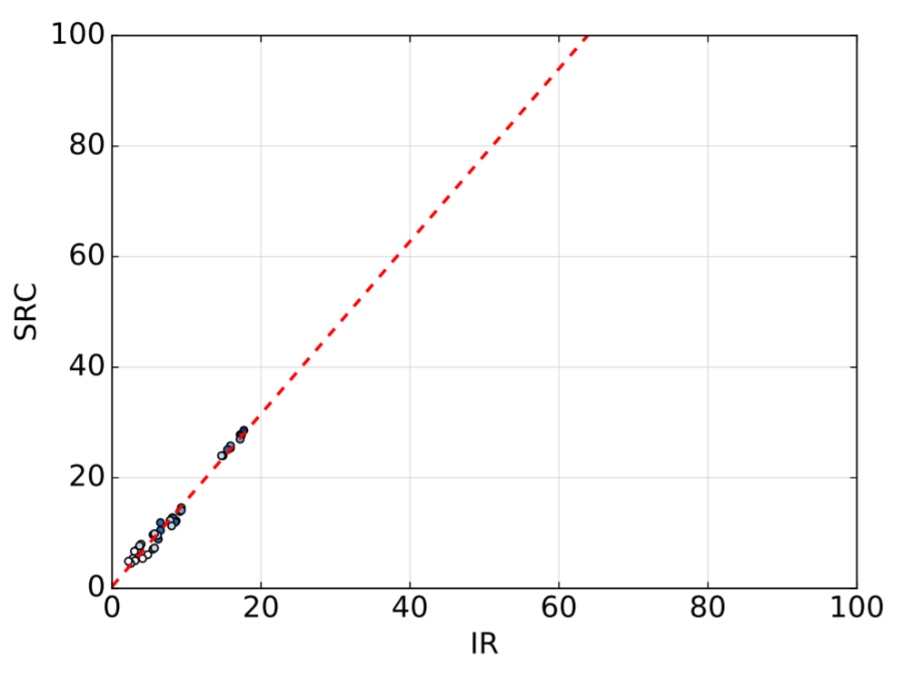
Correlating Scores (per project)
chmod
sum
Average R² value
> 0.8 for all projects
wc

Slide 27
Correlation with Real Faults
Case study using Space
13496 tests, 35 documented faults in fault-matrix
Well-used in prior work on mutation testing
Compare SRC and IR for faults on Space
8647 SRC mutants, 22187 IR mutants
Sample 5000 test suites of size 100
Correlate SRC/IR mutation score of each test suite with faults detected by each using fault-matrix
Notes:
NOTE: Try to make this slide less text, clearer about the process

Slide 28
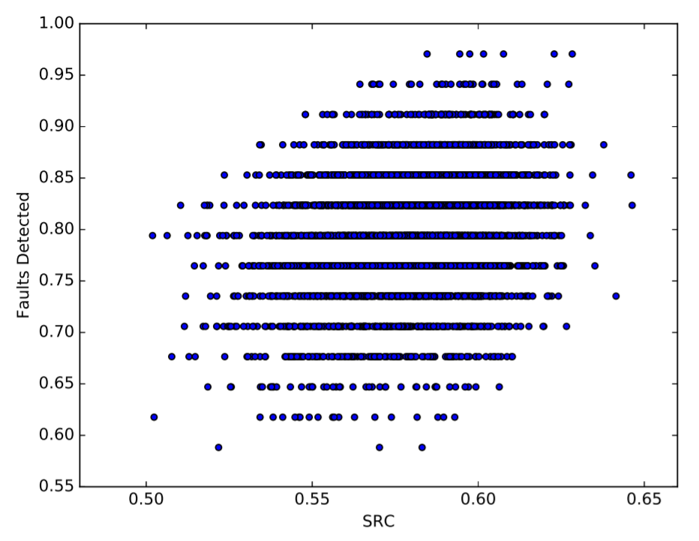
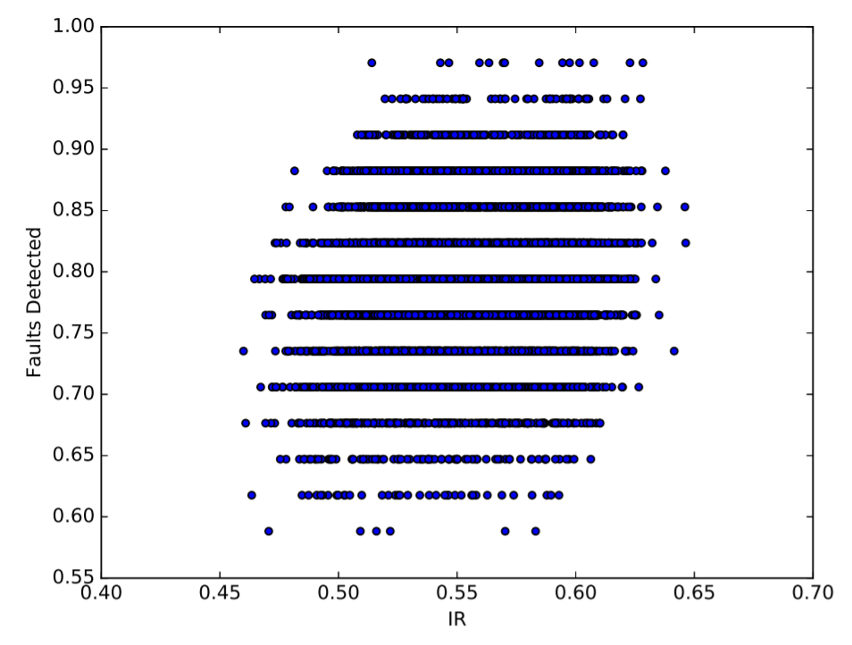
Space Results
IR is better correlated with faults than SRC
R²: 0.30 vs 0.24
Notes:
Kendal-tau: 0.19 vs 0.15

Slide 29
Conclusions
Mutation testing tools can be implemented for either SRC or IR, which should we focus on?
Easier mutant understanding for SRC
Easier multi-language tool development for IR
SRC has fewer mutants
Faster to run
Both SRC and IR indicate test quality similarly
Recommend tools for SRC level
awshi2@illinois.edu
Notes:
To conclude, our goal here is to compare performing mutation testing at different levels of code representation, SRC vs IR, so we can get insight into which level developers/researchers should focus on developing tools for
We’ve discussed some qualitative factors…
Concerning more quantitative factors as of our study we find…
So now the question comes down to which level should we recommend? Now, based on what we’ve found, we are of the opinion that we should recommend developing mutation testing for the level of SRC, as it seems the main toss-up comes down to number of mutants generated, which leads to faster mutation testing time
However, it would be great to discuss any differences of opinion…

Slide 30
BACKUP

Slide 31
Experimental Setup
Evaluate on 15 programs from Coreutils
Split test scripts into scripts that call program individually, create smaller test suites
Compute equivalent/duplicated mutants
Trivial Compiler Equivalence³
Run tests in Docker containers
Could not use all programs from Coreutils
Not enough tests for smaller test suites
Flaky tests
Crashing inside Docker
Notes:
1022 tests

Slide 32
Number of Generated Mutants
Project | # SRC Mutants |  | # IR Mutants
 | Failed | Successful | Failed | Successful
chmod | 269 | 6546 | 1627 | 8288
cut | 64 | 1241 | 385 | 3926
dd | 167 | 5396 | 1696 | 12614
expr | 20 | 535 | 2846 | 13107
factor | 8 | 364 | 10 | 603
head | 47 | 946 | 385 | 3642
readlink | 159 | 2979 | 308 | 3639
seq | 50 | 989 | 789 | 4491
stat | 64 | 1815 | 1102 | 7162
sum | 90 | 2224 | 39 | 922
tac | 99 | 2139 | 1140 | 8238
tail | 139 | 3443 | 1142 | 7847
touch | 129 | 4763 | 2076 | 12662
unexpand | 5 | 343 | 35 | 1174
wc | 91 | 2805 | 2130 | 11796
Many more IR mutants
Mutation testing slower at IR level
Overall | 1401 | 36528 | 15710 | 100111

Slide 33
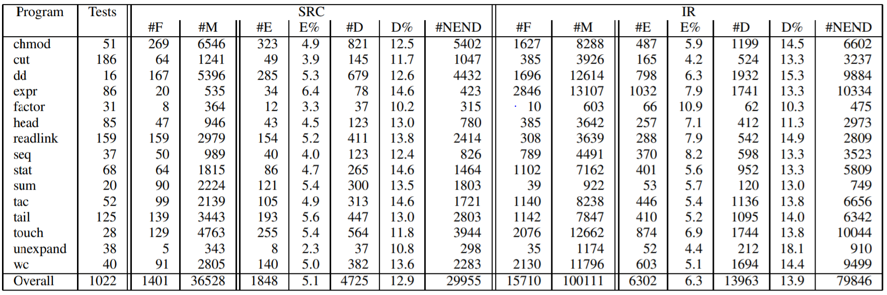
Number of Generated Mutants

Slide 34
Mutation Score

Slide 35
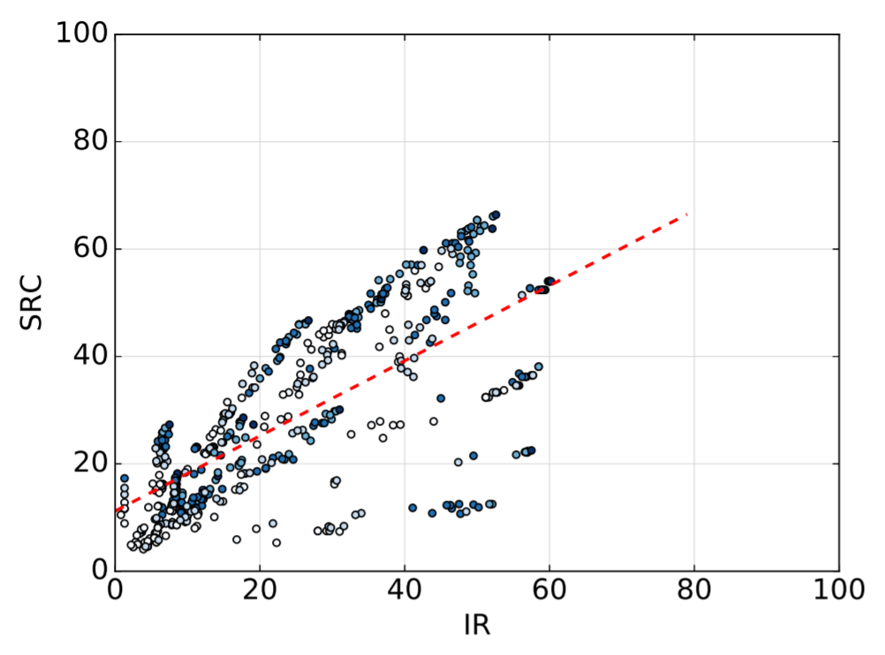
Correlating Scores (all projects)

Slide 36
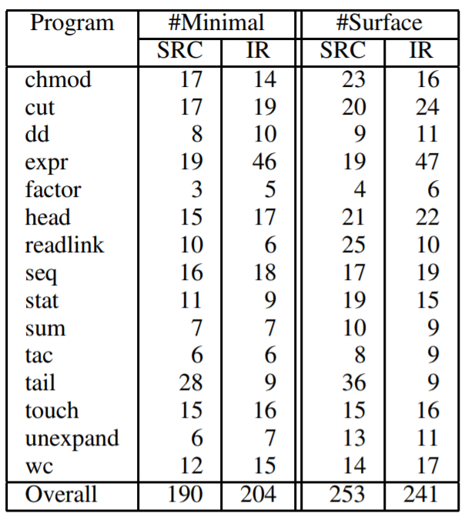
Minimal/Surface Mutants

